Slide 1
Memory Management Overview

Slide 2
Outline
Introduction to memory management
Managing memory with bitmaps and lists
Simple memory management and fragmentation

Slide 3
Introduction to Memory Management
OS needs to manage physical memory
Allocate memory for programs and for itself
Requirements
Isolation: programs should be protected from other programs
Abstraction: programs have the illusion that they have as much memory as their virtual address space
Sharing: programs should be able to share memory with other programs for communication
Goals
Low memory overhead: programs should be able to use as much as memory as possible
Low Performance overhead: CPU should be spend as much time executing programs as possible

Slide 4
Programs and Memory Addresses
When a program is written, it uses variable names
When a program runs, it accesses physical memory addresses
Setting up mapping from program variables to memory addresses requires compiler, linker, OS and h/w support

Slide 5
Compiler, Linker, OS and H/W
Compiler
Converts program source file to object file
Generates relocatable virtual memory addresses
Linker
Links together multiple object files to single program on disk
Generates absolute virtual memory addresses
OS
Loads program into physical memory
Sets up virtual memory hardware
H/W
Translates virtual memory address to physical address

Slide 6
Generating Memory Addresses
On disk
In memory
0
Library routines
1000
Library routines
main()
...
foo()
...
0
main:
...
push ...
jmp 75
...
foo: ...
100
main:
...
push ...
jmp 175
...
foo: ...
1100
main:
...
push ...
jmp 175
...
foo: ...
MMU base register
1000
75
175
1175
Compilation
Linker
OS Loader

Slide 7
Managing Memory
Boot loader, loads OS code and data in low memory
After that, OS needs to track the usage of the rest of the physical memory
OS tracks what memory is allocated (used) or free (unused), similar to heap
addr = kmalloc(size)
Allocate contiguous memory of a given size
Address of allocated memory is returned
kfree(addr)
Program frees memory previously allocated at address addr
Two common techniques for managing memory
Bitmaps, linked lists

Slide 8
Managing Memory With Bitmaps
A Bitmap is a long bit string
One bit for every chunk of memory
1 = in use
0 = free
Size of chunk determines size of bitmap
Chunk size = 32 bits
Overhead for bitmap = 1/(32 + 1) = 3%
Chunk size = 4 KB
Overhead for bitmap = 1/(4 * 1024 * 8 + 1) = 1 / 32769
Larger chunk size
Lower overhead
Wastes more space (on average, half chunk size), called internal fragmentation

Slide 9
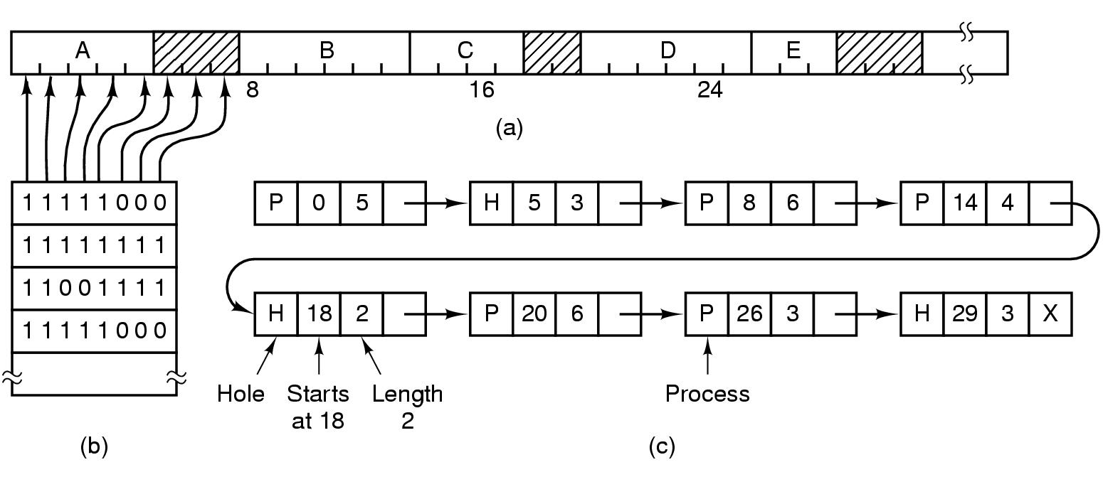
Bitmap Operations
mem = allocate(K)
Search bitmap for K consecutive 0 bits
Set the K bits to 1
Cost: linear search
free(mem, K)
Determine starting bit in bitmap based on memory address
Set next K bits to 0

Slide 10
Managing Memory With Linked Lists
Keep a list of elements, one for each allocated or free region of memory
Each element has the following information
Allocated or free region (hole)
Starting address of memory
Length of region
Pointer to next element of list
0
A
A
A
A
A

Slide 11
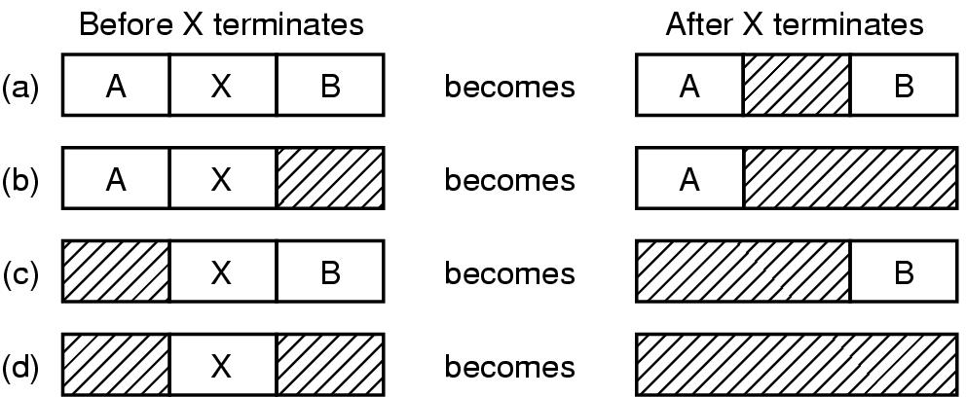
Managing Memory With Linked Lists
mem = allocate(K)
Search linked list for a hole (free region) with size >= K
When size > K, break hole into allocated region, smaller hole
free(mem, K)
Determine region based on memory address
Convert allocated region into hole
Merge with adjacent hole to avoid small holes

Slide 12
Searching Linked Lists
Could use a separate allocated and free list
First Fit: Start searching at the beginning of the list
Best Fit: Find the smallest hole that will work
Tends to create lots of little holes
Quick Fit: Keep separate lists for common sizes
Efficient but more complicated implementation

Slide 13
Simple Memory Management
A basic memory management system assigns each program a contiguous region in physical memory
Region size depends on program size
OS occupies one region
Problems
Internal fragmentation: program doesn’t use entire region
External fragmentation: a large enough region cannot be allocated to the program, even if enough memory is available
Can use compaction, i.e., move processes periodically to collect all free space into one hole, expensive
Allocating additional memory is expensive: can’t grow region, requires copying entire program into another larger region
Notes:
Both types of fragmentation result in wasted, inefficient use of memory and storage

Slide 14
Summary
OS needs to allocate physical memory to programs (and to itself) with low overhead
Bitmaps, linked lists are two methods for managing memory
Programs uses similar techniques for managing their heap
A simple memory management scheme allocates contiguous physical memory to programs
Makes it hard to grow programs
Wastes memory due to internal and external fragmentation

Slide 15
Think Time
What is the difference between a virtual and a physical memory address?
Why is hardware support required for address translation?
How does the OS manage memory using bitmaps? using lists? Under which conditions is each approach preferable?
What is internal and external fragmentation?
Notes:
- difference between virtual and physical
virtual: address seen by CPU, physical: address seen by memory
- h/w support for address translation
Would be too slow in software
Under which condition is bitmap/linked list preferable
Read book
Internal frag: allocated region of memory is not fully used
External frag: holes between allocated regions are fragmented, so large memory allocations are not possible, without compacting allocated regions

